Slide 1
Boston house price predicting model
By:- madhukar thummala(18311A0550)

Slide 2
Contents:-
Introduction
Data Processing
Data visualization
Normalization of data
Mean Square Error
Visualization of Model
Prediction of Prices

Slide 3
Introduction
What is machine learning ?
Machine Learning is a study of computer algorithms that comprises of algorithms and statistical models that allow computer programs to automatically improve through experience.
3 Types of machine learning :
Supervised machine learning.
Unsupervised machine learning.
Reinforcement learning.

Slide 4
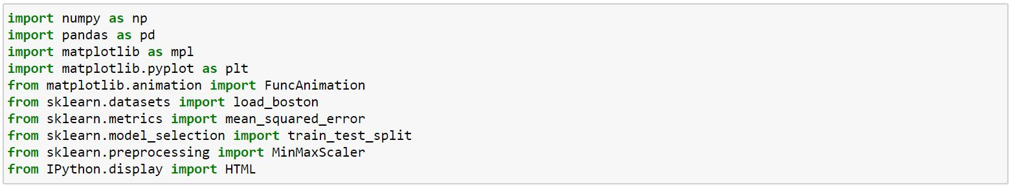
packages :

Slide 5
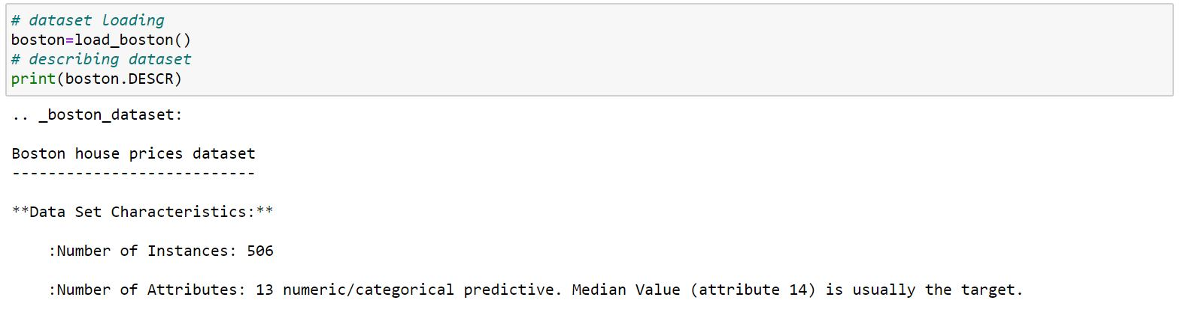
Data Processing

Slide 6
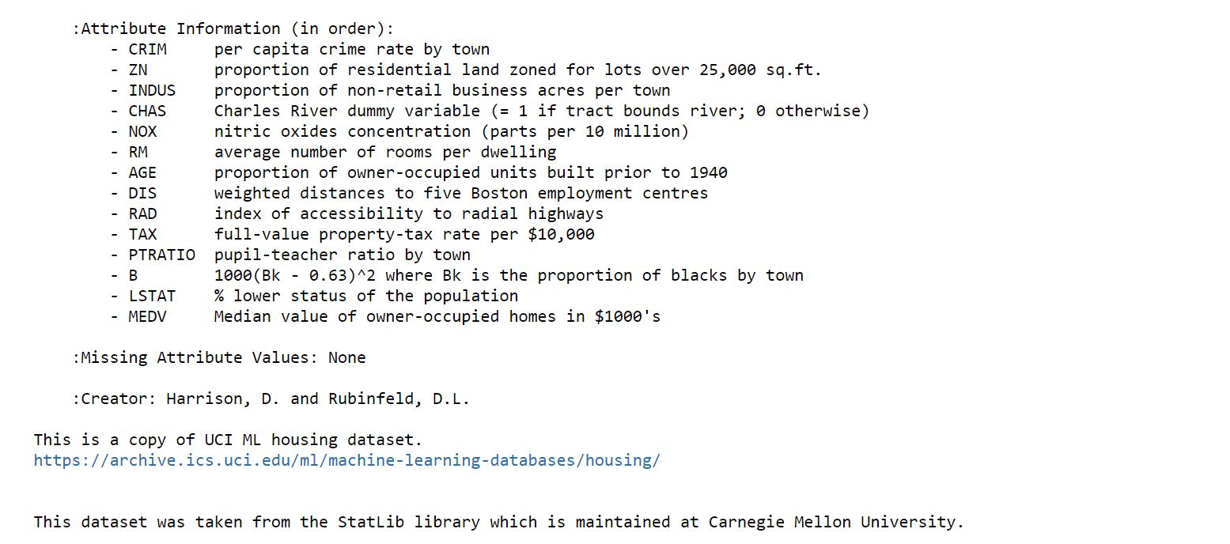

Slide 7
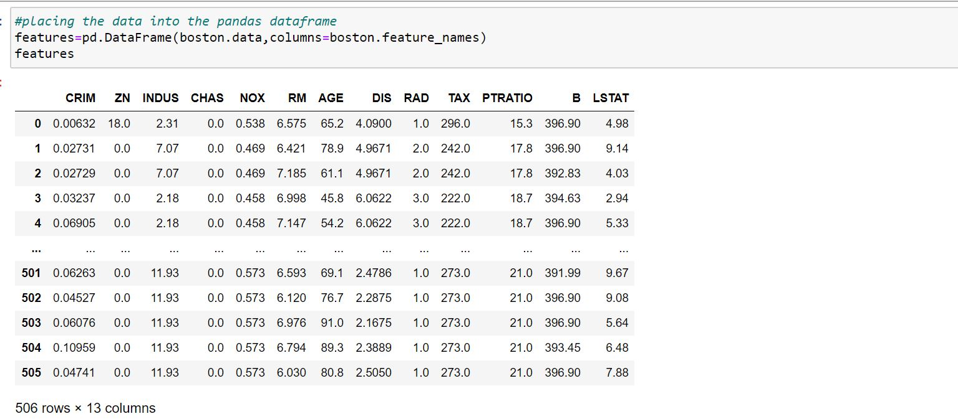

Slide 8
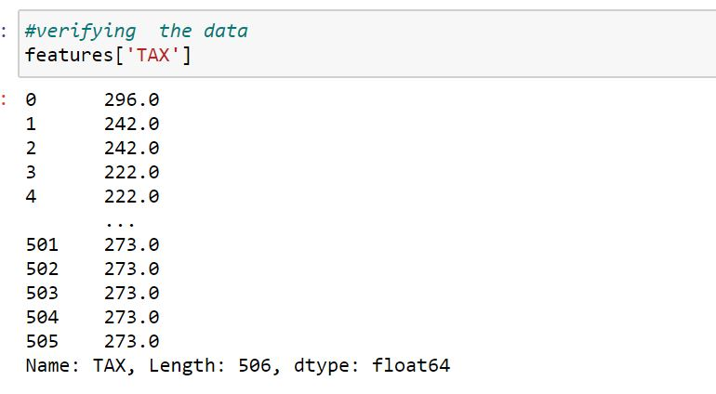

Slide 9
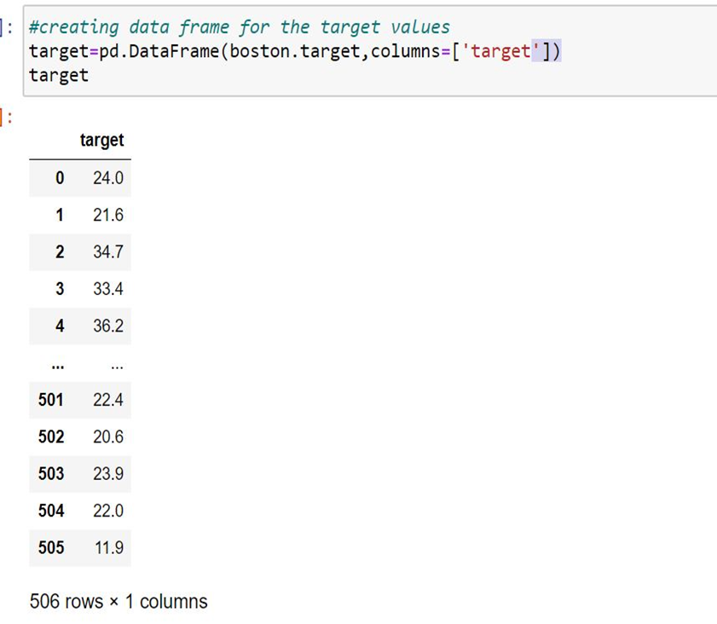

Slide 10
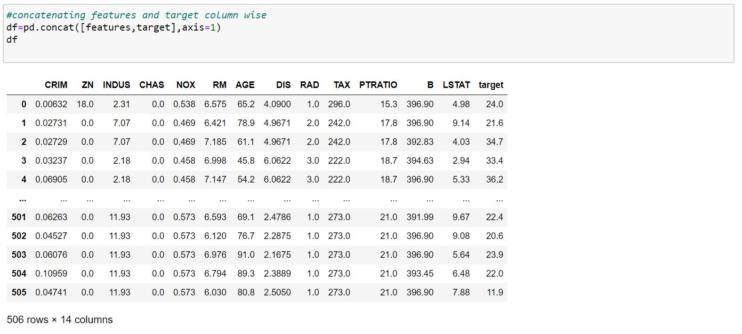

Slide 11
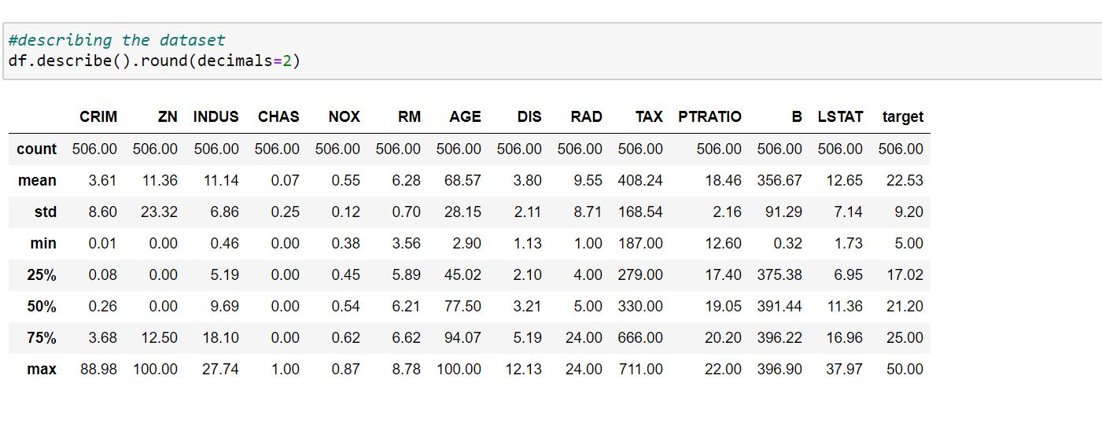

Slide 12
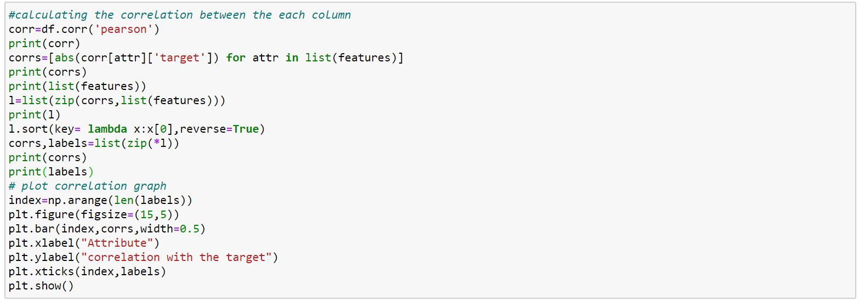
Data Visualization

Slide 13
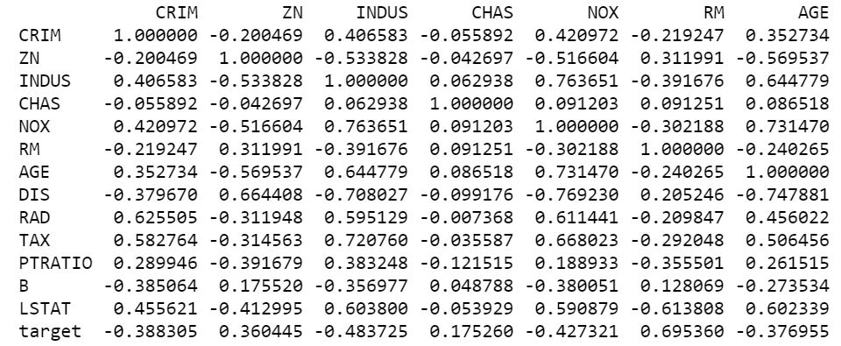
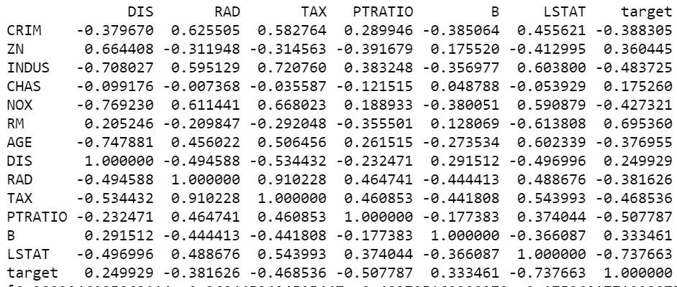

Slide 15
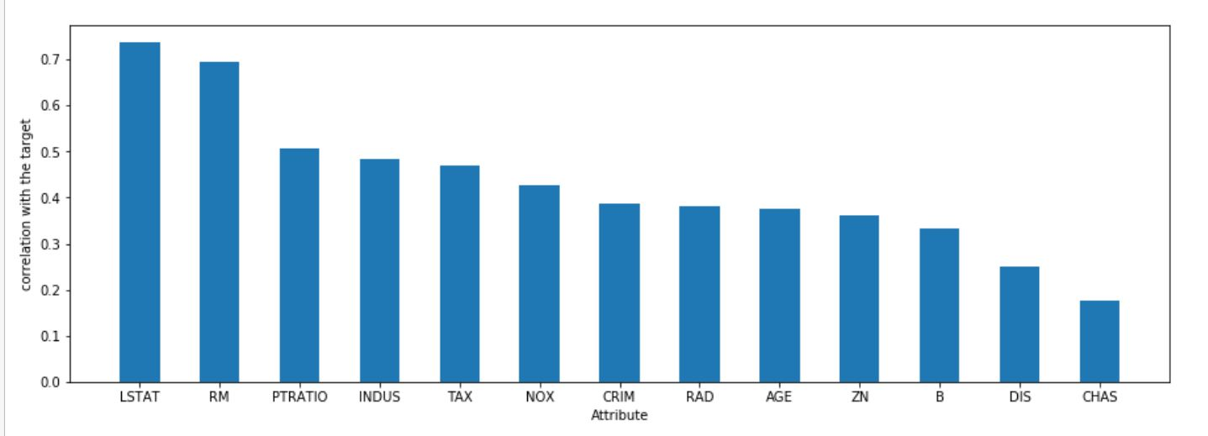

Slide 16
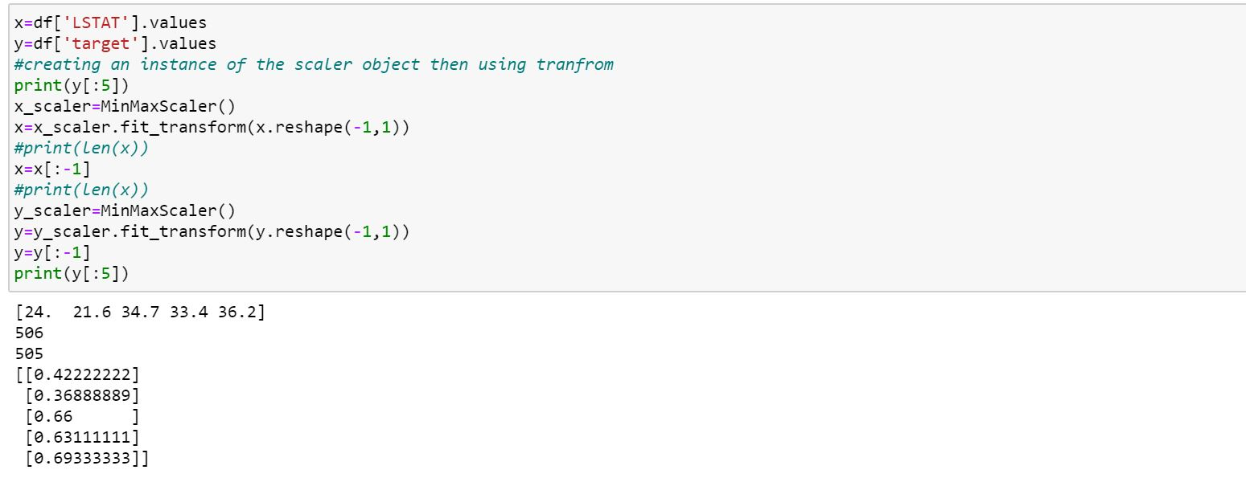
Normalization

Slide 17
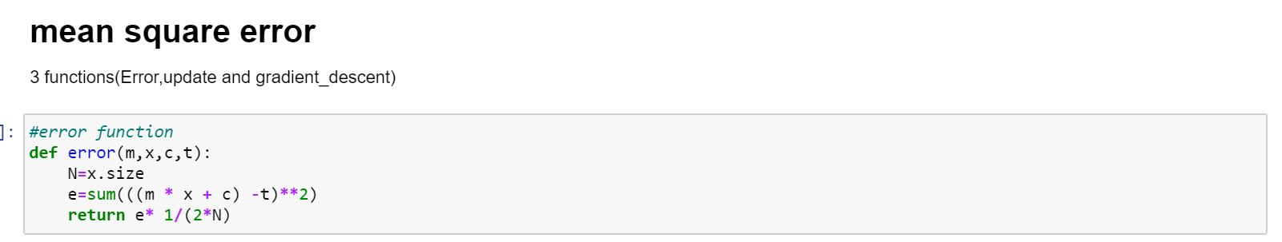
Splitting the data

Slide 18
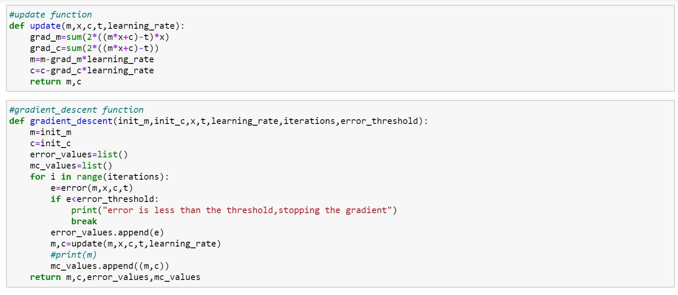

Slide 19
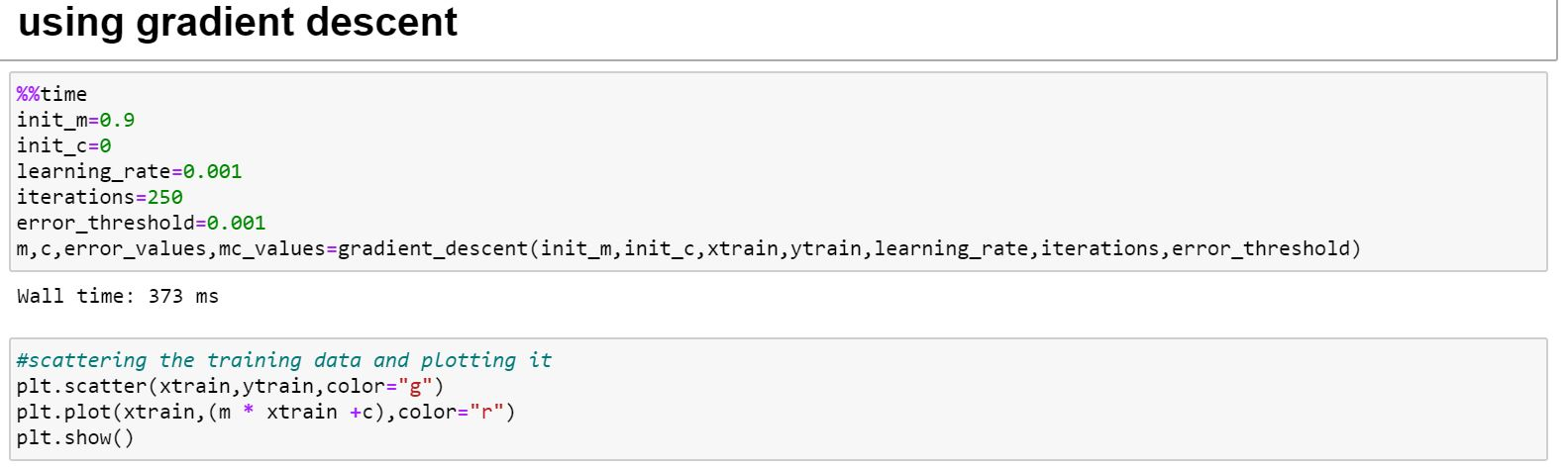
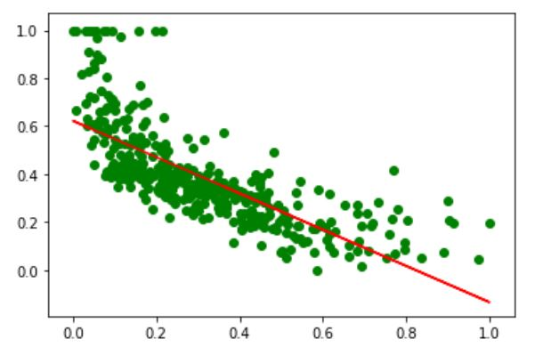

Slide 20
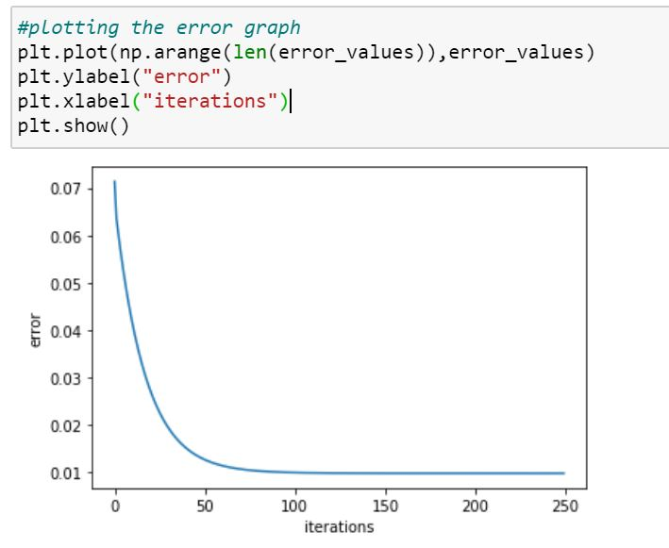

Slide 21
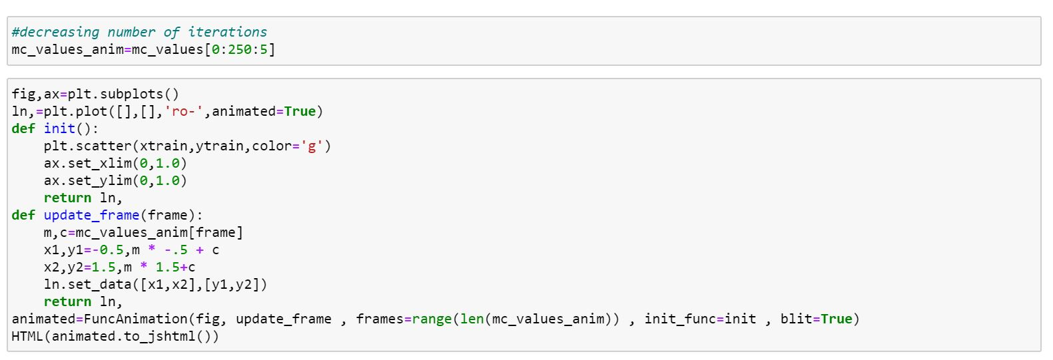
Visualization

Slide 22
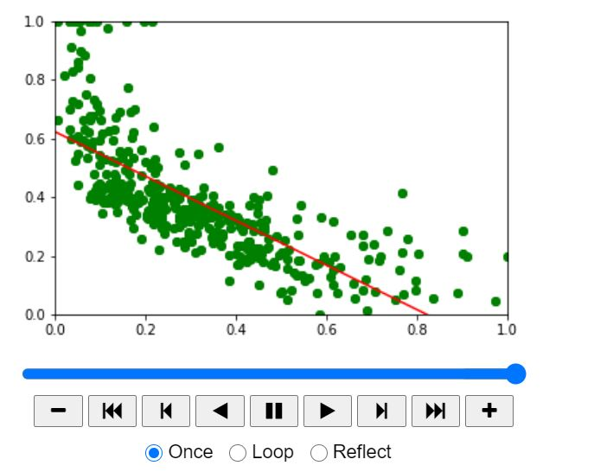
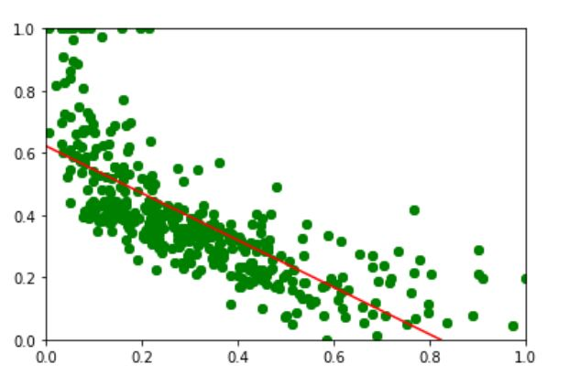

Slide 23
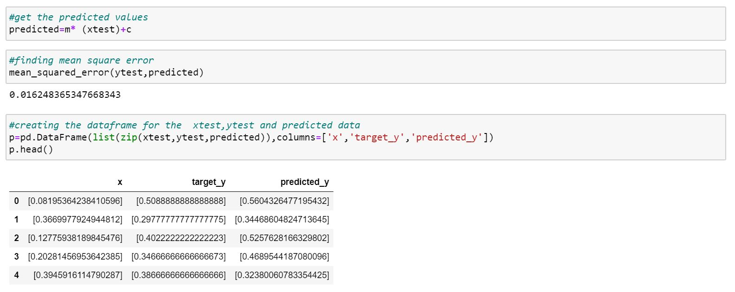
Prediction of prices

Slide 24
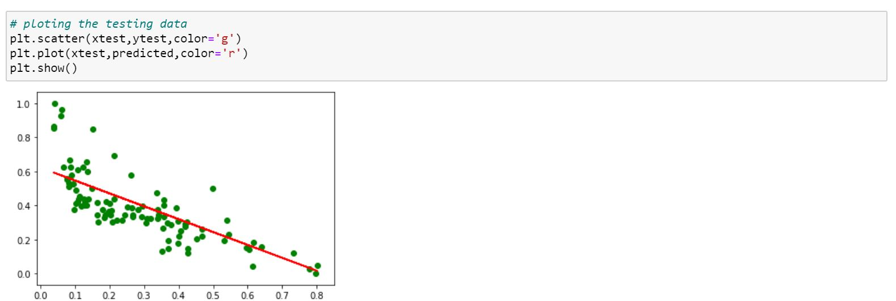

Slide 25
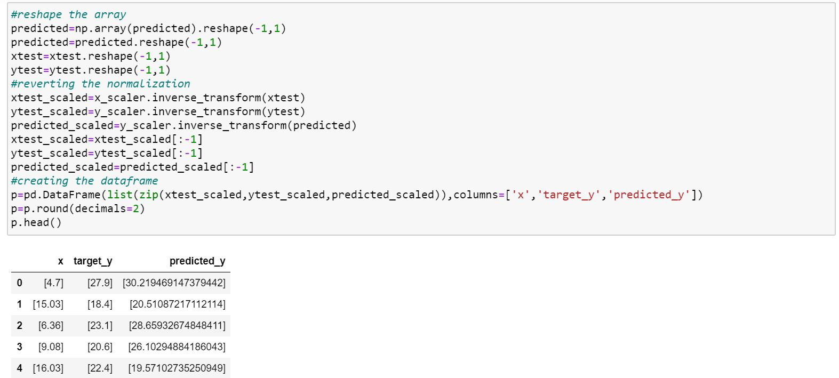

Slide 26
conclusion
I think this topic will help many people those who want to construct their own dream house .Many people can know what are the features to construct the house. This topic helps me a lot to learn more about linear regression.

Slide 27
Thank You

